Slide 1

NSG Pilkington – University of Liverpool Machine Learning Project: 16/09/2020
Dr. Peter Green
Diego Echeverria
Risk Institute,
School of Engineering
11/08/2020

Slide 2
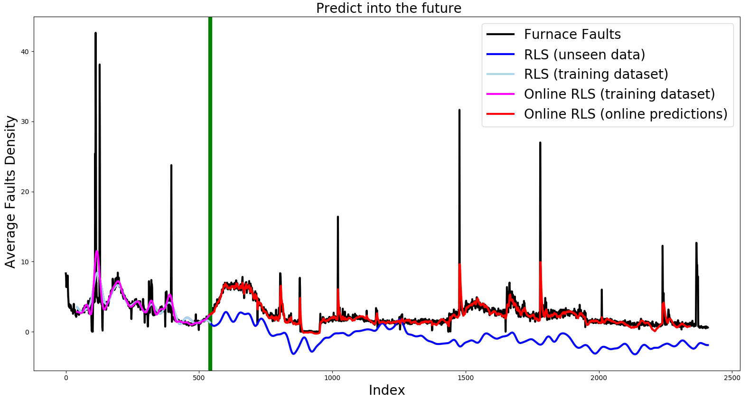
Online regularized least squares Time lag = 15 hours
Actual error = 65.17 %

Slide 3
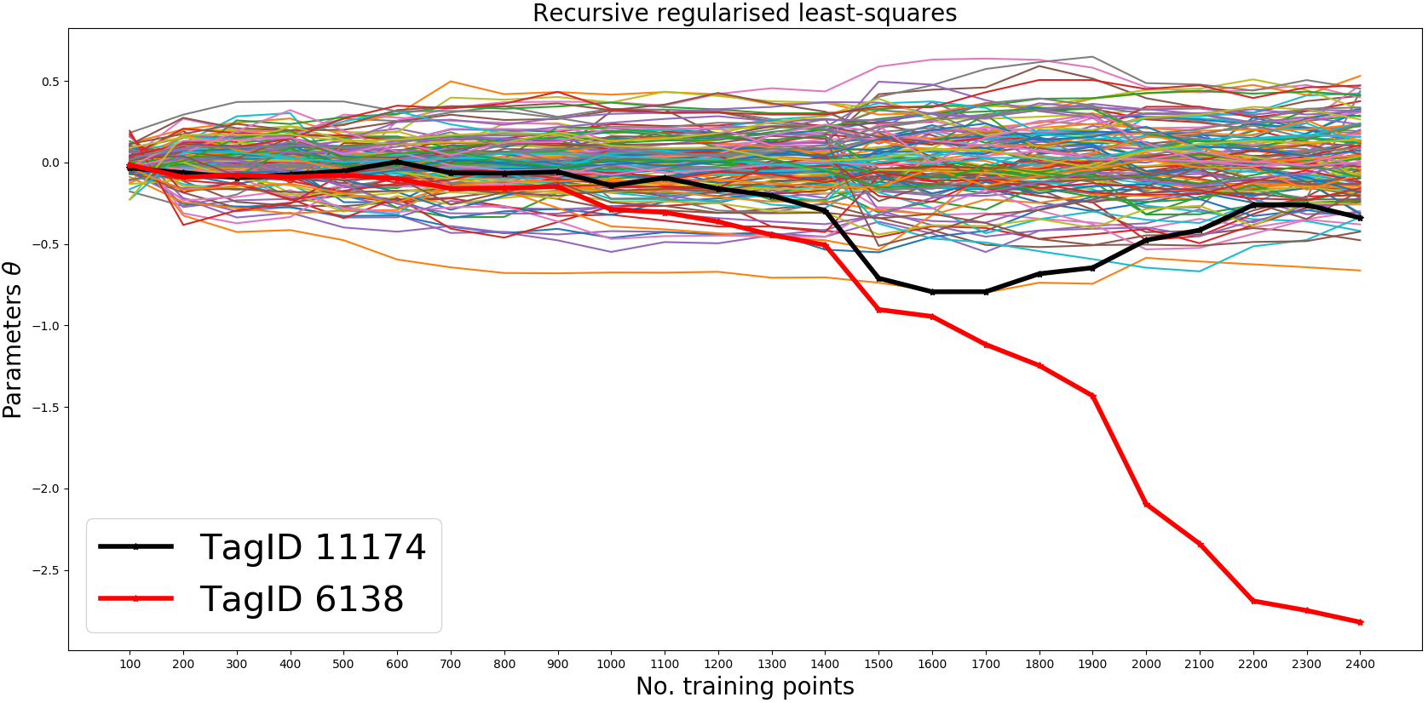
Online Least Squares: No time lags Using data that have not been analysed by the process experts
Regularised parameter= 4.2

Slide 4
Online Least Squares: No time lags Using data that have not been analysed by the process experts
The error
NRMSE (RRLS): 117.5123 %
Original N of Tags: 130
NRMSE = Normalised Root Mean Squared Error
RRLS = Recursive Regularised Least Squares
We eliminate Tags whose parameter values are less than 0.02
NRMSE: (RRLS): 117.5360 %
N of Tags eliminated: 7
N Tags after elimination: 123

Slide 5
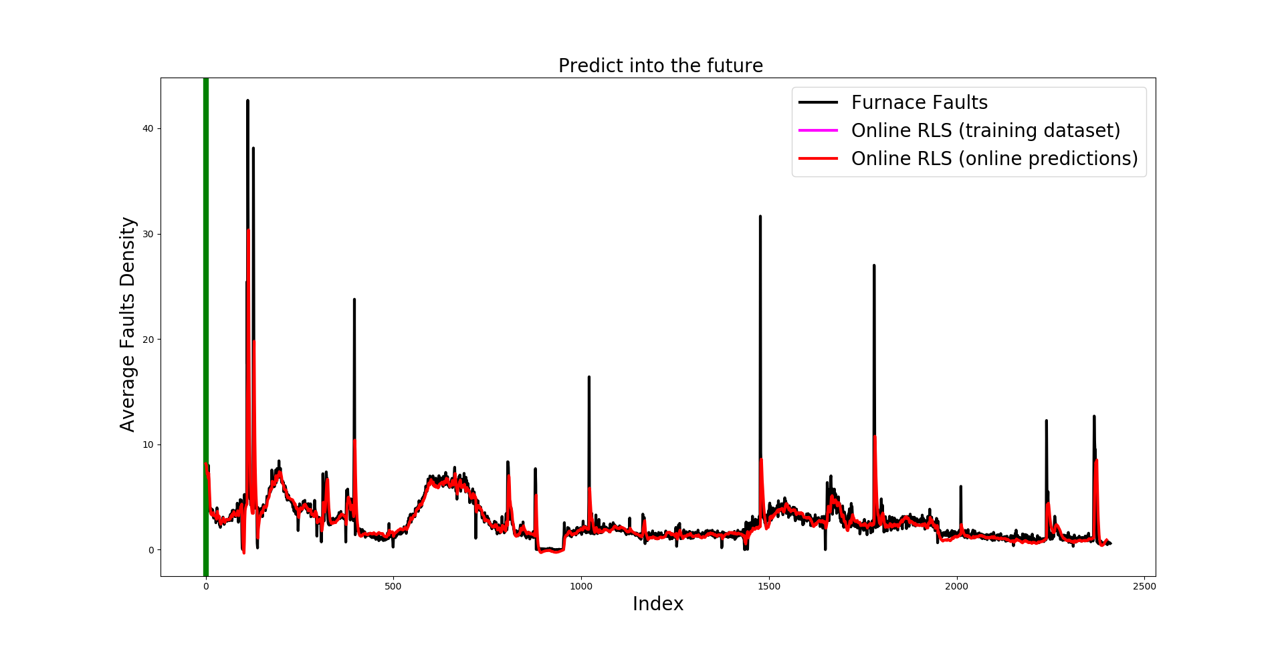
Online regularized least squares Time lag = 0 hours, No time lag

Slide 6
Eliminated Tags
Eliminated | Description
TagID 10278 | Canal Temp. Control (OP)
TagID 136 | Total Combustion Air Flow Measurement
TagID 2798 | Silo 20 Tonnage
TagID 6113 | PCP Ammonia Tank Level
TagID 7398 | PCP V003 Delta P
TagID 9393 | Glass Level Control (OP)
TagID 9399 | Port 2 Gas Flow (OP)

Slide 7
Online Least Squares: No time lags Using data that have not been analysed by the process experts
Regularised parameter= 4.2

Slide 8
Online Least Squares: No time lags Using data that have not been analysed by the process experts
The error after eliminating the Tags whose parameters are less than 0.02
NRMSE: (RRLS): 117.5123 %
N of Tags eliminated: 7
N Tags after elimination: 122
Eliminating TagID 6138, increased the error:
NRMSE: (RRLS): 154.5010 %
N of Tags eliminated: 8
N Tags after elimination: 121
37% error increase

Slide 9
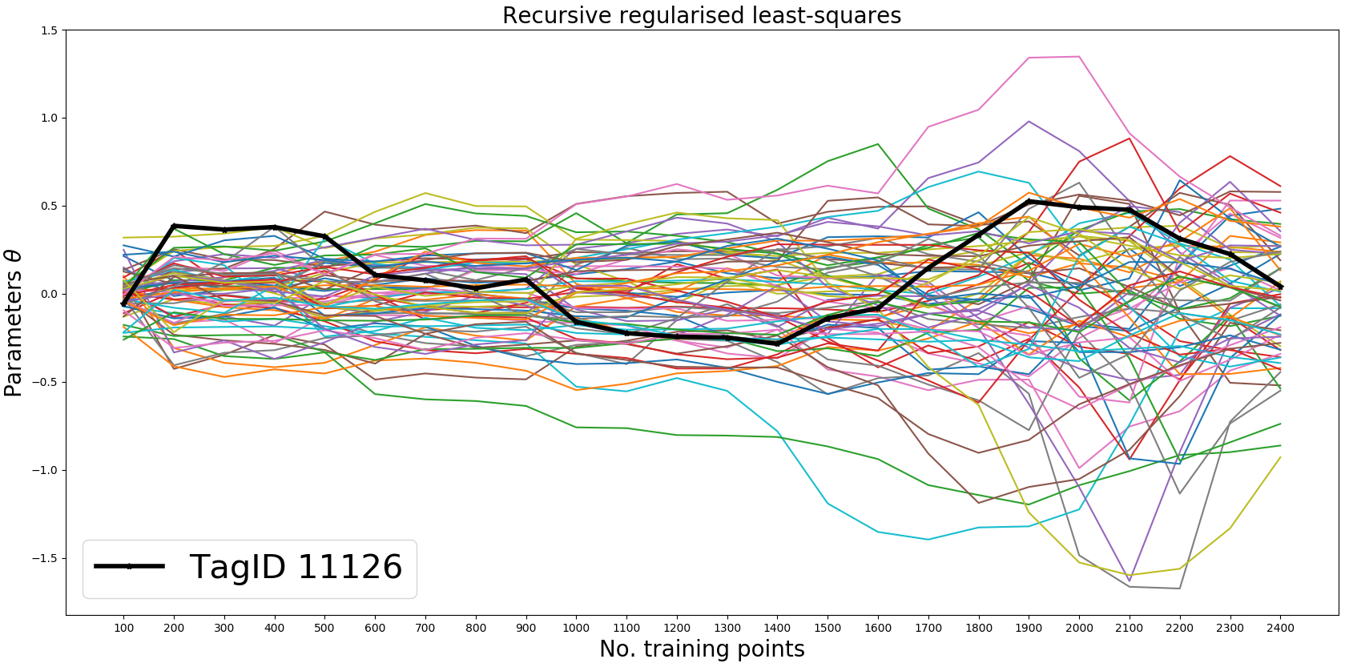
Online Least Squares: No time lags Using data that have been analysed by the process experts
Regularised parameter= 9.8

Slide 10
Online Least Squares: No time lags Using data that have been analysed by the process experts
The error
NRMSE (RRLS): 145.27942 %
Original N of Tags: 70
We eliminate Tags whose parameter values are less than 0.02
NRMSE: (RRLS): 145.89439 %
N of Tgas eliminated: 5
N Tags after elimination: 65

Slide 11
Eliminated Tags
Eliminated | Description
TagID 11213 | Essential Services Board Cat 'B' Supply - MV53
TagID 1356 | Regenerator Crown Temperature Port 4 LHS
TagID 136 | Total Combustion Air Flow Measurement
TagID 7482 | Front Wall Temperature 8
TagID 9501 | Port 7 Gas Flow (OP)

Slide 12
Comparison between Tag datasets
 | Tags (ML) | Tags (UEK)
0 | TagID 10271 | TagID 10279
1 | TagID 10274 | TagID 10425
2 | TagID 10279 | TagID 105
3 | TagID 10298 | TagID 11105
4 | TagID 10424 | TagID 11123
5 | TagID 10425 | TagID 11126
6 | TagID 10444 | TagID 11132
7 | TagID 105 | TagID 11135
8 | TagID 11105 | TagID 11145
9 | TagID 11106 | TagID 11174
10 | TagID 11107 | TagID 11201
11 | TagID 11123 | TagID 11209
12 | TagID 11125 | TagID 11211
13 | TagID 11126 | TagID 11217
14 | TagID 11129 | TagID 11221
15 | TagID 11132 | TagID 11226
16 | TagID 11141 | TagID 11273
17 | TagID 11145 | TagID 11282
18 | TagID 11174 | TagID 11298
19 | TagID 11182 | TagID 11299
20 | TagID 11183 | TagID 11300
21 | TagID 11201 | TagID 11384
22 | TagID 11204 | TagID 12720
ML = Machine Learning
UEK = Using Experts Knowledge
The Tags not highlighted in red are common Tags

Slide 13
Conclusions
The Machine Learning approach to eliminate the Tags was successful.
Eliminate Tags using Machine Learning techniques and then use experts knowledge to validate the final dataset?
Use the error to compare the predictive performance of the original and modified datasets.
Discussion on techniques that can provide the actual time lags.

Slide 14
Thank you for your attention. ANY QUESTIONS?

Slide 15

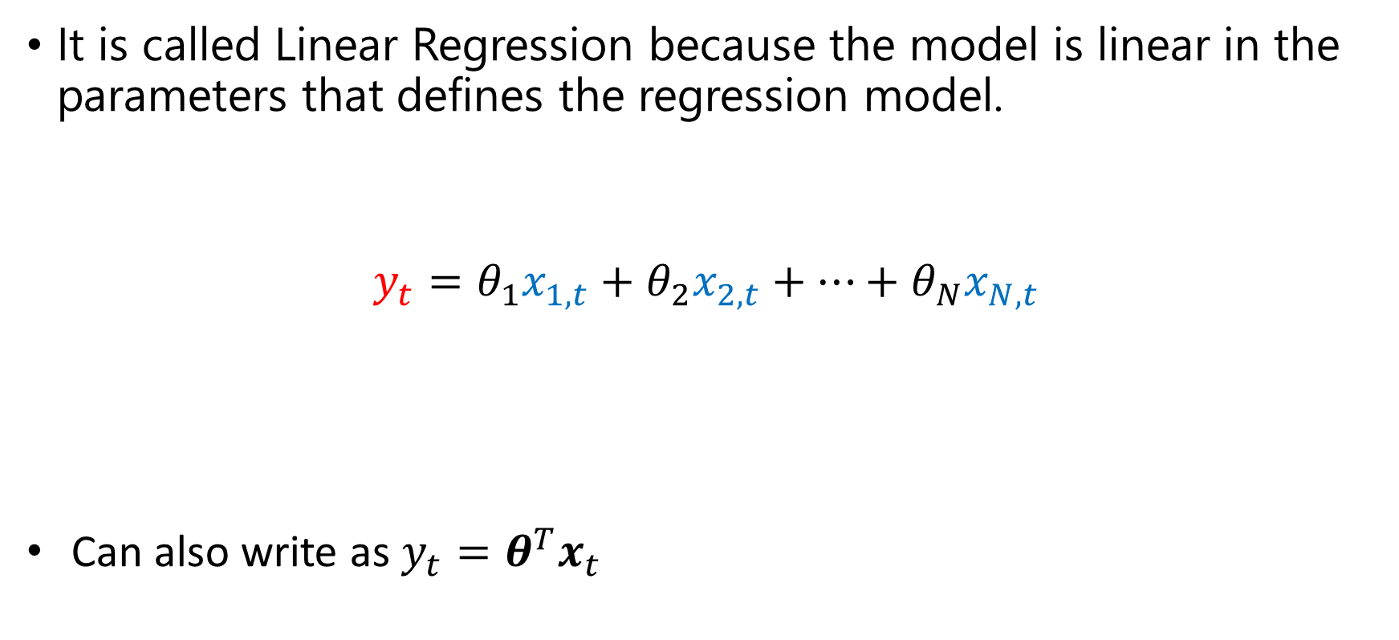

Linear Regression: Lest Squares
It is called Linear Regression because the model is linear in the parameters that defines the regression model.
$$y_{t}=θ_{1}x_{1,t}+θ_{2}x_{2,t}+…+θ_{N}x_{N,t}$$
Can also write as $y_{t}=θ^{T}x_{t}$
Total faults at time $t$
Tag data at time $t$

Slide 16
Regression using Machine Learning techniques
As we give more information about the latent process (Furnace Faults), the relationship between the inputs and outputs would be clearer to the ML algorithm.
Hence, incrementing the number of observations would ease the learning process.
In other words, we should be able to see how the model converge to a solution as we increase the number of observations.

